Slide 1
Beer Restaurant Success
By Samantha Wright, Ryan Walkley, Andrew Holt, and Hanna Kim

Slide 2

Selected Topic:
Predicting success of beer-serving businesses
Reason for selection:
Want to discern factors that lead to beer-serving business success

Slide 3
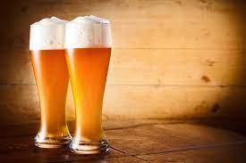
Main Dataset: Beer_Permit_Locations.csv
Displays beer-serving business permit information [1]
Data is specific to businesses in Nashville area - i.e., Davidson County [1]
Data provided by Beer Permit Board [1]
Administrates “all laws and ordinances relating to beer and like alcoholic beverages” [3]
Obtained from Data.Nashville.gov
Publicly accessible data portal containing datasets related to various Nashville businesses, agencies, and departments[2]

Slide 4
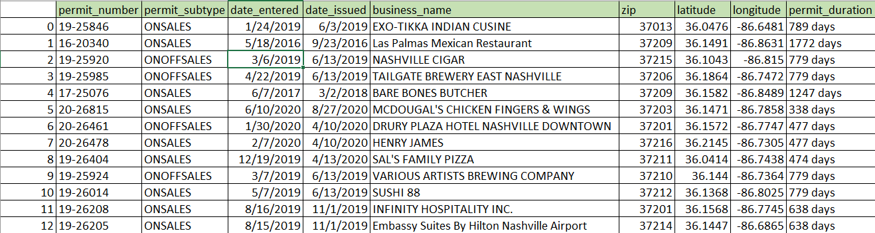
Variables of Interest
Notes:
permit_number: permit unique identifier [1]
permit_subtype: “System code for the permit subtype” [1]
date_entered: “Date the permit was entered into the system” [1]
date_issued: permit issue date [1]
business_name: “Name of the business to which the permit is issued” [1]
zip: business location zip code [1]
latitude: latitude coordinate of business location
longitude: longitude coordinate of business location
permit_duration: number of days business has held permit
Calculated by subtracting date_issued from present day date

Slide 5
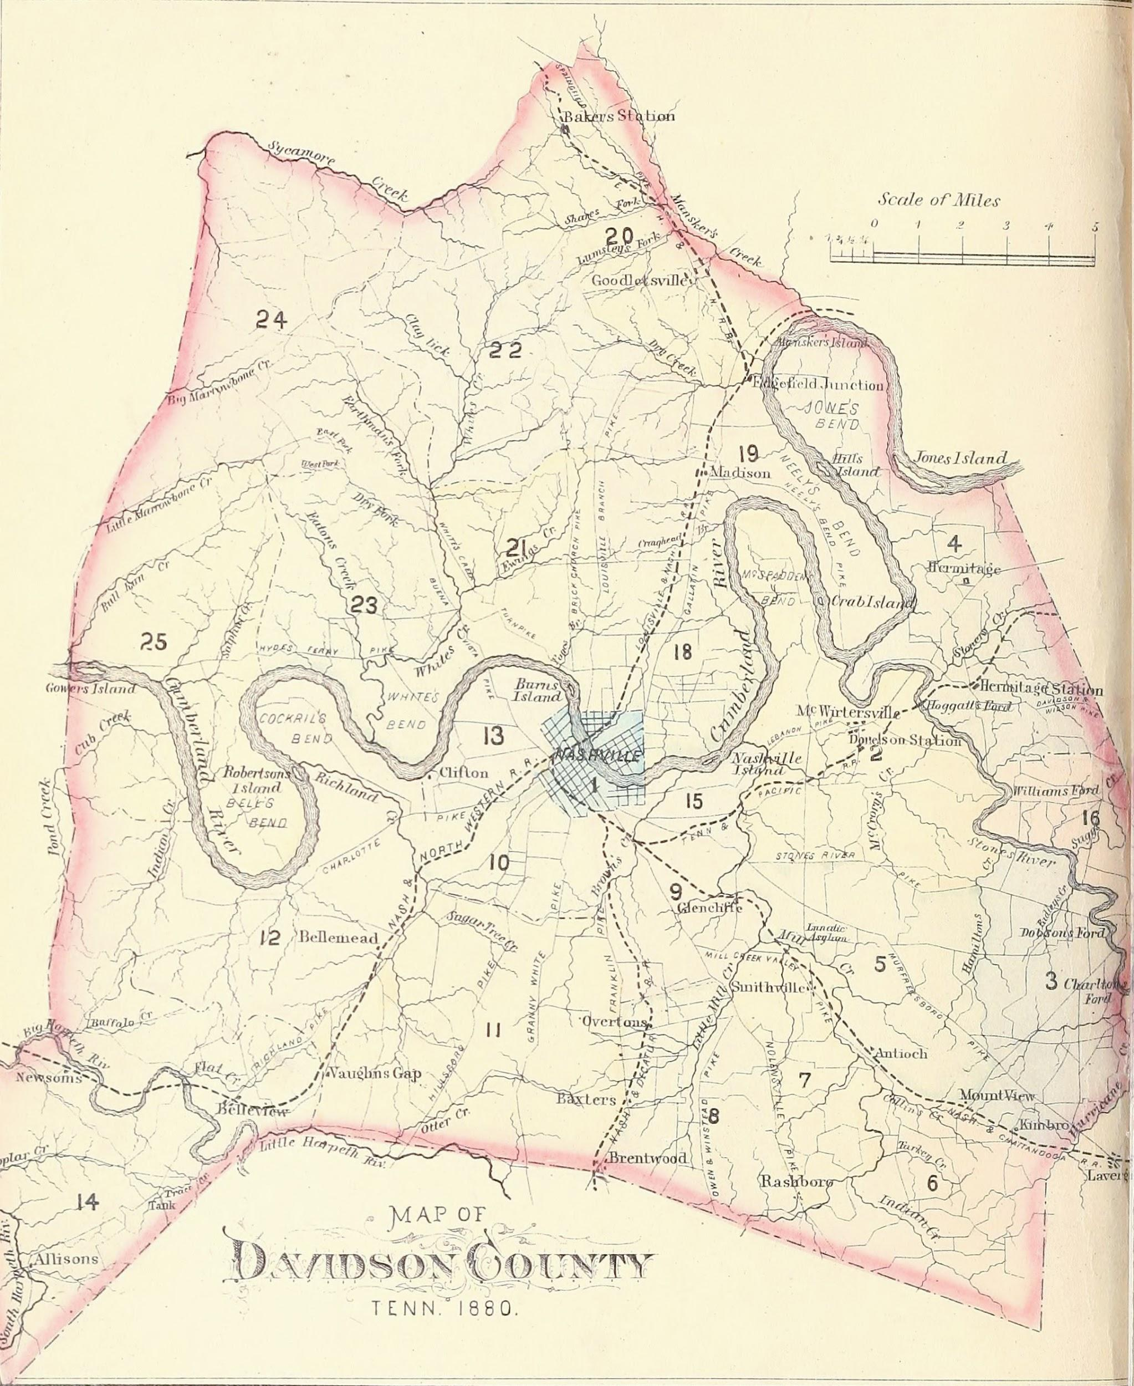
demographics_by_zip.csv
Displays various demographic data for every zip code area in Davidson County except one
Race
Gender
Age
Etc.
Data provided by United States Census Bureau
“[Their] goal is to provide the best mix of timeliness, relevancy, quality and cost for the data [they] collect and services [they] provide” [4]
Obtained from Census.gov
“Provid[es] current facts and figures about America’s people, places, and economy” [4]

Slide 6

education_by_zip.csv
income_by_zip.csv
Displays education levels for different demographic groups found in Davidson County
Data provided by United States Census Bureau
Obtained from Census.gov
Displays different income types for different demographic groups found in Davidson County
Household income
Per Capita Income
Etc.
Data provided by United States Census Bureau
Obtained from Census.gov

Slide 7
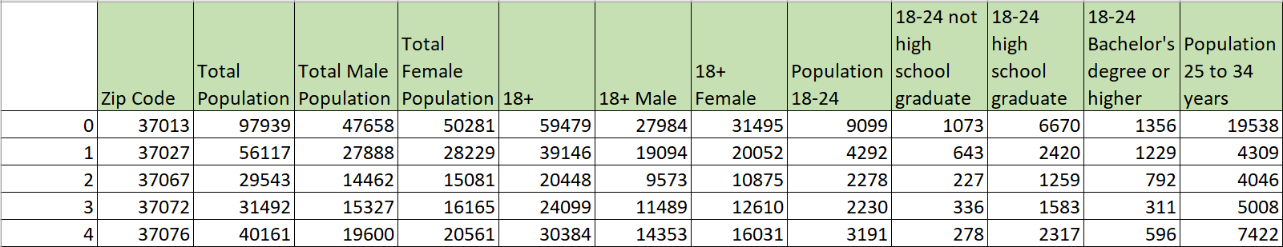
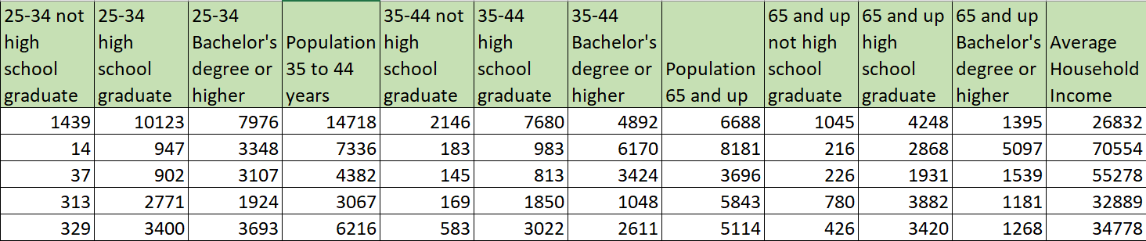
Variables of Interest in Merged Demographic Dataset

Slide 8

Question to Answer
Based off of Beer Permit and demographic data, in which zip code will one be more successful when opening a beer serving establishment in Davidson County?

Slide 9
Data Exploration Process

Slide 10
Main Dataset Search
Found Beer_Permit_Locations.csv dataset on Data.Nashville.gov
After download, had following variables:

Slide 11
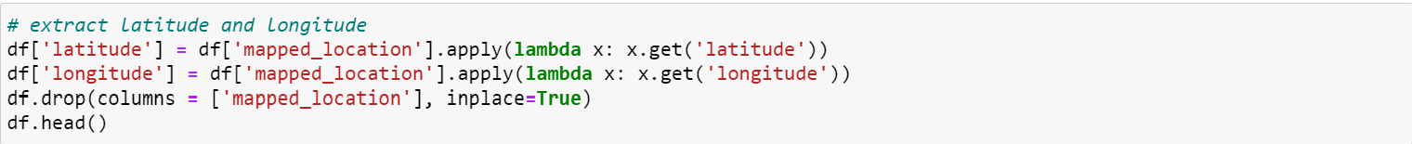
Main Dataset Cleaning and Transformation
Imported dataset into jupyter notebook as dataframe
Pandas was used to clean and transform dataset
Searched for and removed duplicates
Rows with null values dropped
Columns with irrelevant data were removed
longitude and latitude column values were extracted from Mapped Locations column values
Mapped Locations column subsequently deleted
permit_duration values calculated and added as column to dataset

Slide 12
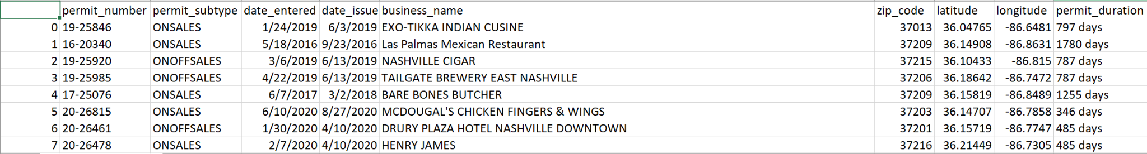
Main Dataset Export
New, cleaned dataset exported as beer_permit_data_V1.csv

Slide 13

Database and Machine Learning Model Creation
Created RDS instance and S3 bucket in AWS
To allow data in database to be accessed by all group members
Connected pgadmin to RDS instance
Created tables to hold beer_permit_data_V1.csv data
Used jupyter notebook to fill in pgadmin tables with beer_permit_data_V1.csv data
Used jupyter notebook to create starter code for unsupervised machine learning model
Took data from database and outputted labels

Slide 14
Data Analysis Process

Slide 15
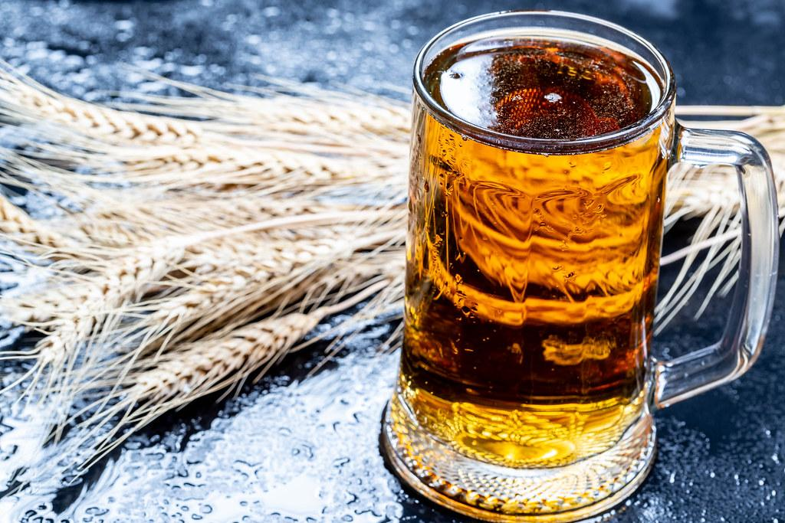
Additional Database Setup
Finished transforming beer_permit_data_V2.csv dataset
Found 3 census datasets for Davidson County from census.gov
Covered general demographic, education, and income information
Each dataset cleaned individually then merged into single dataset
Done using jupyter notebook
Added cleaned, merged census dataset to postgres database
Also added it to another S3 bucket for public use

Slide 16
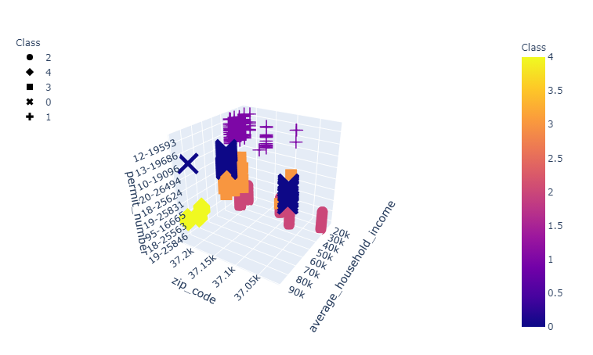
Machine Learning Model
Clustering model grouped data but did not answer question

Slide 17
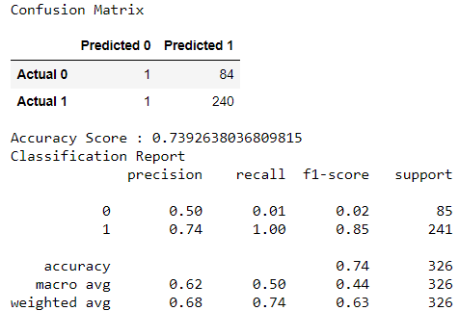
Machine Learning Model
Made random forest model to answer question
Achieved sufficient accuracy

Slide 18
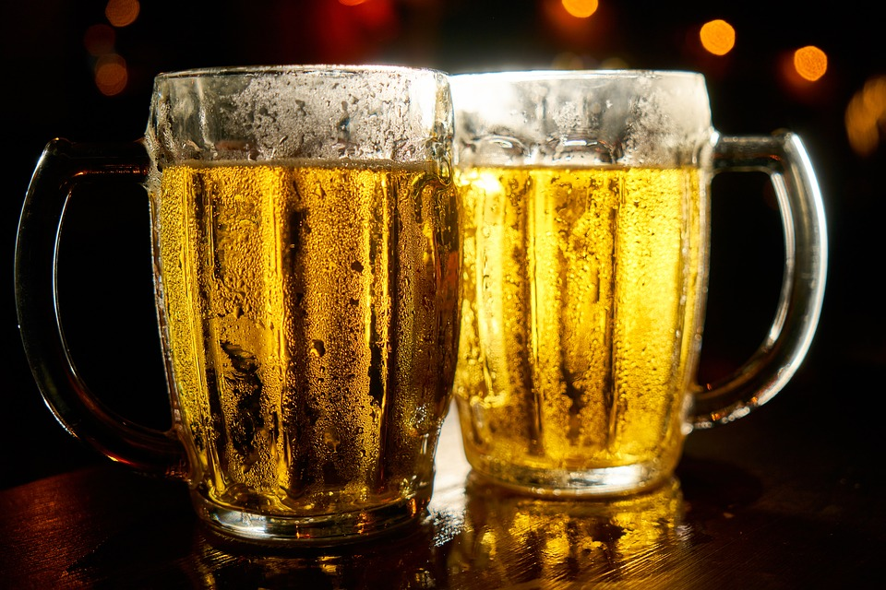
Dashboard Creation
Imported beer_permit_data_V2.csv and merged demographic datasets to Tableau
Created visualizations for analysis
Created dashboard explaining our topic and results
https://public.tableau.com/views/Beer_Restaurant_Success_Visualizations_16288178489470/BeerSuccess?:language=en-US&publish=yes&:display_count=n&:origin=viz_share_link

Slide 19
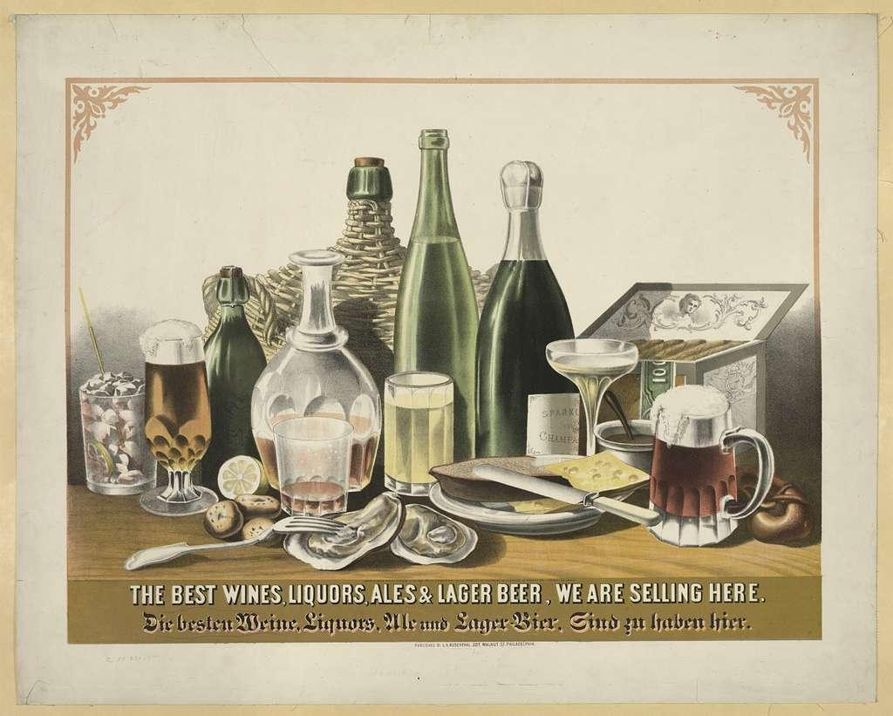
Technologies Used
Data cleaning and analysis:
Pandas for cleaning and transforming data and exploratory analysis
Python for further analysis
Database storage
Postgres
Flask for data display
AWS
RDS instance for connection to pgadmin
S3 buckets
Machine Learning
Sci-kit Learn
Dashboard
Flask, Tableau, and D3.js

Slide 20
Sources
https://data.nashville.gov/Licenses-Permits/Beer-Permit-Locations/3wb6-xy3j
https://data.nashville.gov/
https://www.nashville.gov/Government/Boards-and-Committees/Committee-Information/ID/53/Beer-Permit-Board.aspx
https://www.census.gov/

